Slide 1
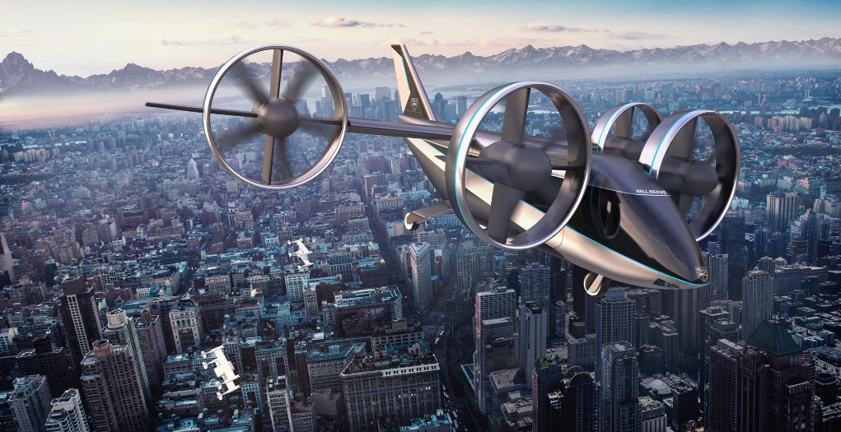
e-VTOL Flying Testbed
Sam Drury
03/12/2020
Supervisor:
Dr Sam Grimshaw
Whittle Laboratory

Slide 2
Structure
Intro and motivations (2-3 mins)
Present setup, method (1-2 mins)
Mention FOM
Display results (2 mins)
FOM comparison (ND) with props and edf at different rpms
Ch’ic of EDF
Play video and discuss (1 min)
Conclude and present next steps (2 mins)

Slide 3
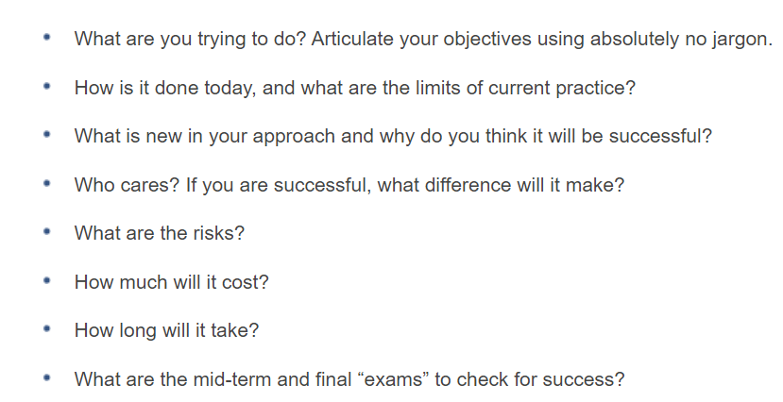
What, How, Why
Currently propellors, but EDFs have multiple performance benefits
Design and build a VTOL EV with ducted fans for propulsors
Have a flying testbed to simulate various test cases – ref 5 stage flight
Can also assess trade-offs between number of propulsors and size
Fan can be characterised, so operating point can be easily obtained

Slide 4
What have I done this term
Familiarised self with existing MATLAB design code to design new propulsor - updated areas where necessary (eg adding sweep/lean, creating stator holes)
Successfully operated static rig with all interfaces working
Repaired drone chassis, designed new connecting arms, fiddled with printing too many times
Collected performance results from different designs, attempted to produce ch’ic by varying sigma (WORK TO DO HERE)
Confirmed FOM improvement from prop to EDF
Adapted design to accommodate new motors
Built up drone to fly with 4x EDF’s

Slide 5
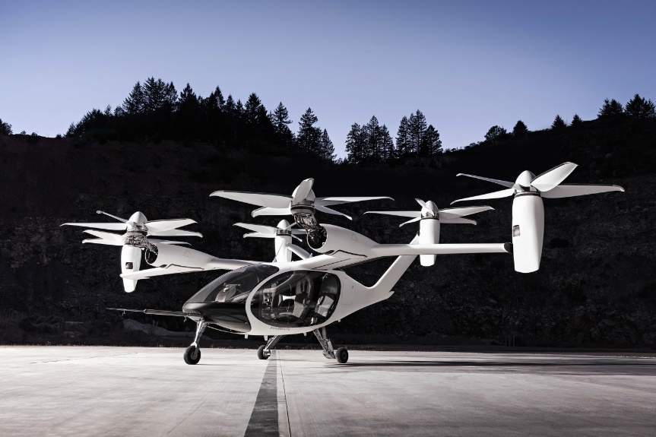
Growth of the eVTOL Market
Notes:
Electric Vertical Take off+landing veh seen as one of the Great emerging technologies of the time
Market size expected to quadruple by 2025
https://www.marketresearchfuture.com/reports/evtol-aircraft-market-7952
High speed commuting, traffic-free
Quieter and cheaper than heli
Zero emission local electric power
Scope to cost same/mile as other ride sharing platforms
Even greater benefits can be envisaged using DUCTED FANS

Slide 6
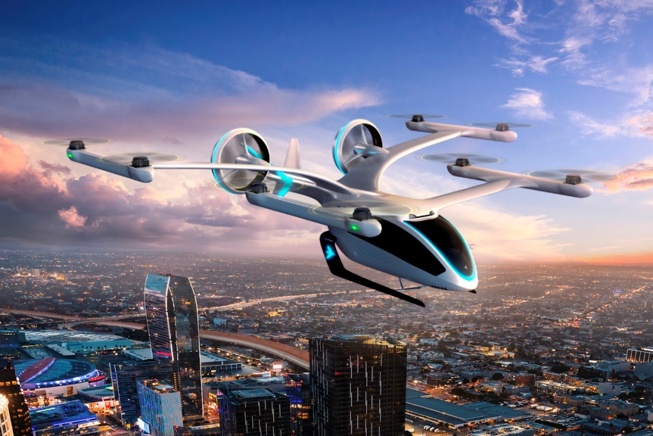
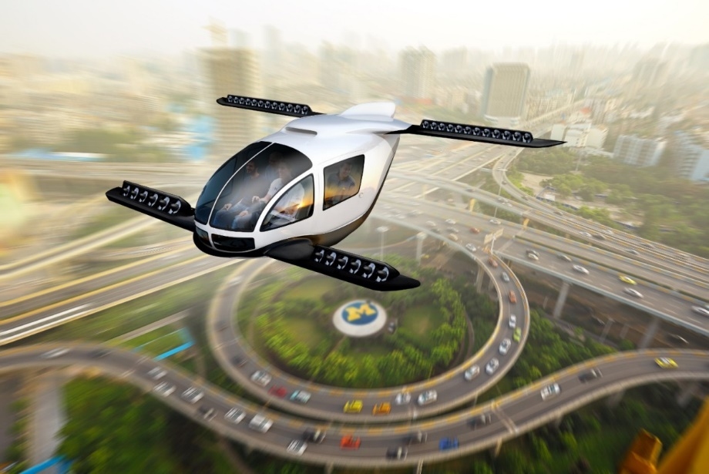
Growth of the eVTOL Market
Notes:
DUCTED FANS
Quieter from shrouding
Safer – also in terms of a crash
Performance benefit – shrouding the flow field, forcing flow diffusion, reducing exit jet velocity, greater pressure recovery
BUT is it worth it?

Slide 7

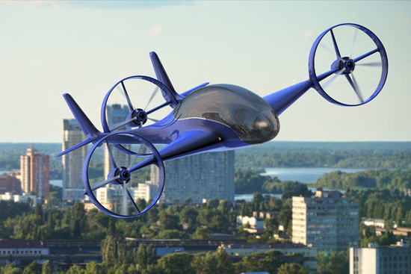
Visualising Breadth of eVTOL Design Space
Notes:
Comparisons between concepts from Ford on left and Honeywell/Jaunt Air Mobility demonstrate the size of the design space for urban air mobility VTOL electric vehicles, from many small rotors to few large; comparison with commercial liners – 2/4
Building a modular flying test bed will allow the trade-offs inherent in the variation of designs to be assessed and quantified, for various test flight cases
Short for urban air mobility (heathrow to canary, JFK to downtown)
Longer for Ox-Camb
This acts as a precursor to the upcoming work by Blue Bear (SAMMMM)
These stages of flight are explored

Slide 8
Exploring Different Stages of Flight
Take-Off
Notes:
Working fully against gravity

Slide 9
Exploring Different Stages of Flight
Climb
Notes:
Top of Climb may be critical due to lower density (Thrust proportional to density)
Also, diagram here shows direction of travel parallel to fan axis – may not be so, so inlet flow may be distorted

Slide 10
Exploring Different Stages of Flight
Cruise
Notes:
More crucial to optimise for here when range is longer

Slide 11
Exploring Different Stages of Flight
Descent
Notes:
Critical that descent is controlled and steady, not affected significantly by crosswinds etc

Slide 12
Exploring Different Stages of Flight
Landing
Notes:
Finally landing

Slide 13
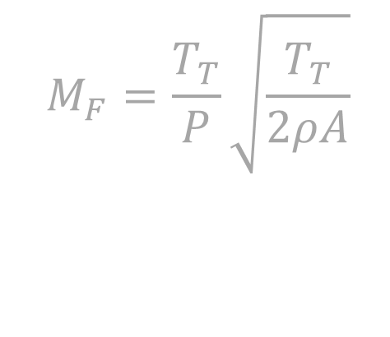
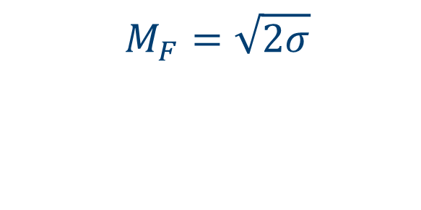



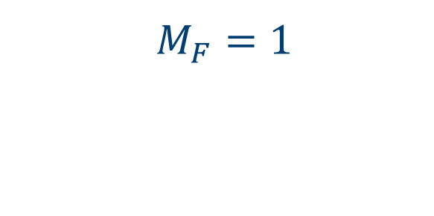
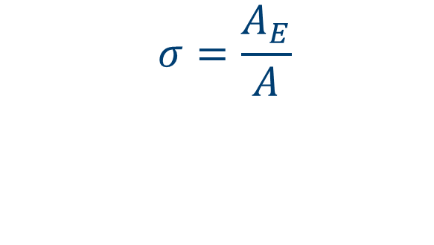
Devising a Suitable Performance Metric
$$M_{F}=\frac{T_{T}}{P}\sqrt{\frac{T_{T}}{2ρA}}$$
$$A$$
$$A$$
$$A_{E}$$
$$M_{F}=1$$
$$M_{F}=\sqrt{2σ}$$
$$σ=\frac{A_{E}}{A}$$
Notes:
Pereira/CV analysis
Greater diffusion, less KE loss – limit due to adv P causing BL separation, not as much pressure recovery, effective sigma less

Slide 14
3 Aims
Ducted Fan design for hover
Characterising EDF
Flying testbed
Stability
In-flight measurements

Slide 15
Design methods
1D design
Assumptions
Flowchart of thought process

Slide 16
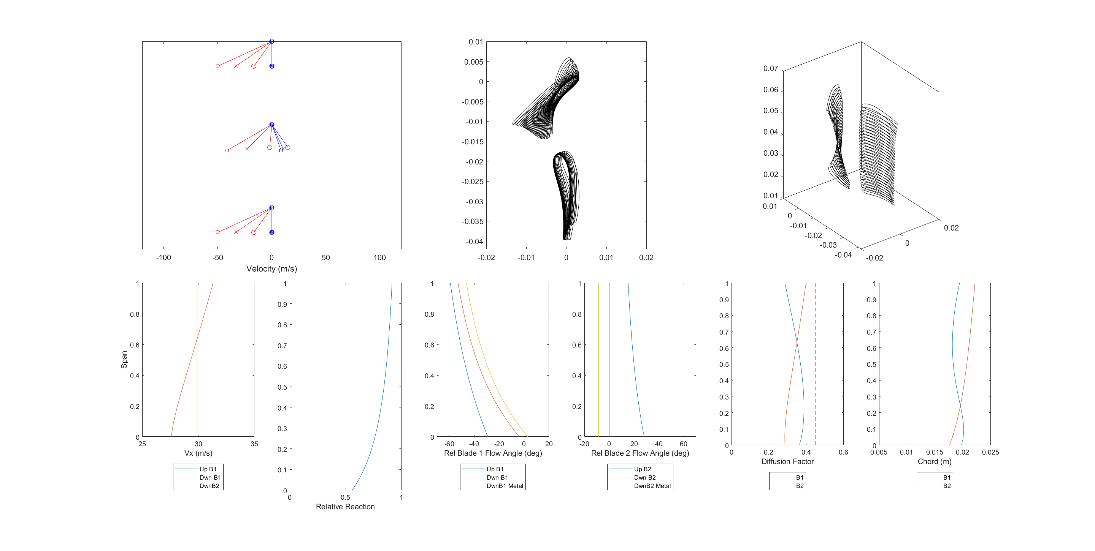
Generating Blade Profiles
Inputs
Φ, σ, Thrust, Geometry
Relative Velocities
Vx
Absolute Velocities
SFME
SFEE
Isentropic Flow
INCREASE sizes

Slide 17
Generating Blade Profiles
Radial Equilibrium
Notes:
Midline as basis!!

Slide 18
Generating Blade Profiles
Lieblein
Carter
Notes:
Midspan chord set by Lieblein DF
Midspan blade metal angles by Carter’s empirical relation from compressor cascade tests
Constant deviation across span sets rest of angles

Slide 19
Generating Blade Profiles
Lieblein
Carter
.5 vortex exp, unif c
Notes:
Chord recalculated based on constant deviation (Carter’s rule)
Deviation Factor recalculated across span according to Lieblein’s correlation

Slide 20
Generating Blade Profiles
Rotor
Stator
Notes:
Lean, Sweep – Taylor & Miller

Slide 21
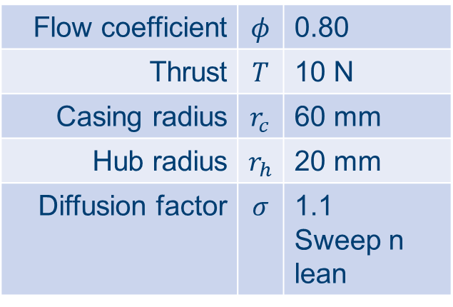
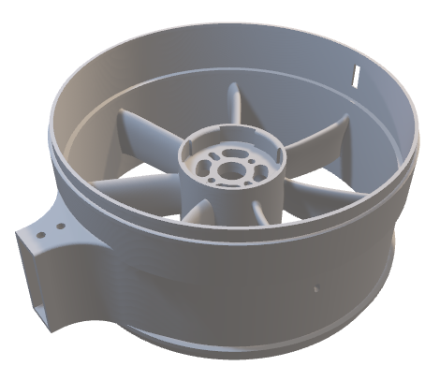
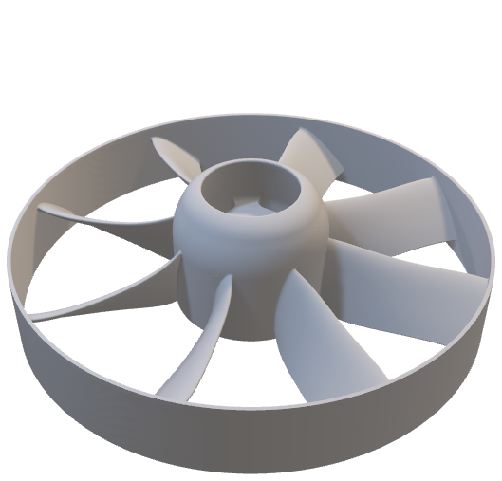
Chosen Design
Flow coefficient | $$φ$$ | 0.80
Thrust | $$T$$ | 10 N
Casing radius | $$r_{c}$$ | 60 mm
Hub radius | $$r_{h}$$ | 20 mm
Diffusion factor | $$σ$$ | 1.1 Sweep n lean
Notes:
Replace image with Mine
Rotor-stator, long intake and moderate diffuser
Stator takes out swirl
Printing!!!!
Static tests, ch’ic perf

Slide 22
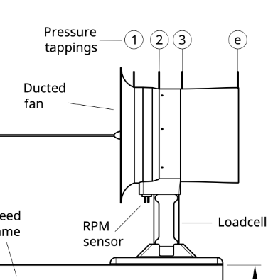
Measuring Thrust, RPM, Pressure, Power
PIC OF THING
Test Stand
Notes:
Overview of interfacing with

Slide 23
Measuring Thrust, RPM, Pressure, Power
Drone Hardware
Test Stand
Notes:
Overview of interfacing with

Slide 24
Thrust Measured
Data Collection
Raspberry Pi
SSH over WiFi
Thrust
Shear Loadcell
Notes:
Loadcell calibration
Secure shell

Slide 25
Measuring Thrust, RPM, Pressure, Power
Data Collection
Raspberry Pi
SSH over WiFi
RPM
RPM Sensor
Notes:
Secure shell

Slide 26
Measuring Thrust, RPM, Pressure, Power
Data Collection
DSA Pressure Transducer
Ethernet
DSA

Slide 27
Measuring Thrust, RPM, Pressure, Power
Data Collection
QGroundControl
Telemetry
Power
Notes:
Same computer terminal

Slide 28
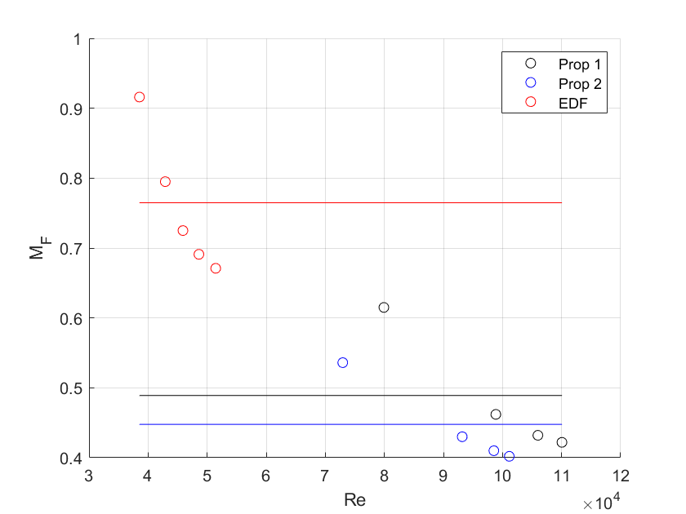
Validating Ducted Fans against Propellors
Bar chart
Error bars (stdev)
Single speed
EDF>props
Notes:
Re based on max chord, V1 rel
Can adjust to mean line chord to bring props in line with EDF
Not accounting for system efficiency
Variation due to power
Change colour of graph?
Compared to JSE – far away from design point!! Low variations – he was 1.1-1.4x10^4

Slide 29
Obtaining Ducted Fan Characteristic by Varying σ
Needs done in MATLAB, data needs recollecting following RPM sensor issue, expanded towards bottom right, include design point
Notes:
Stall
Temperature sensitivity
Mention diffusion ducts
Includes spanwise variation due to vortex exponent
Once this is obtained, can obtain OP from flight through knowing RPM, technically SFME gives Vx for hover

Slide 30
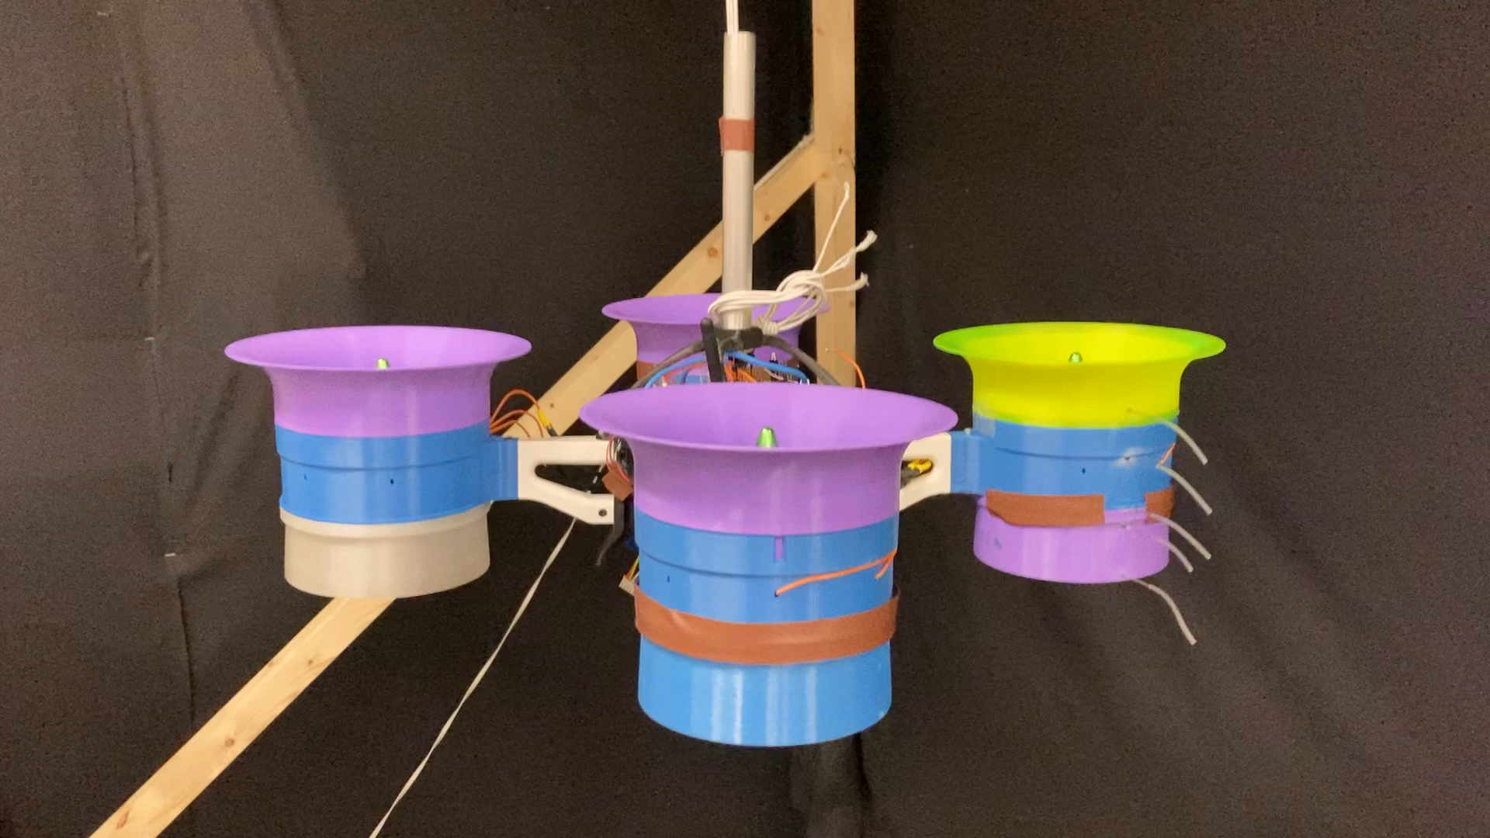
First Test Flight in Whittle Lab eva
Notes:
Needs renaming

Slide 31
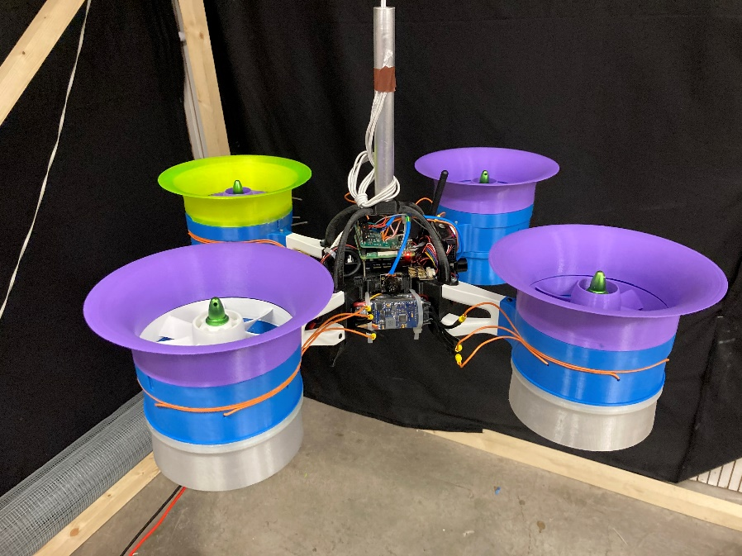
Capacity to Conduct Dynamic Tests
Laptop
Pixhawk4 Flight Controller
Power Module (PM07)
RPi3 A+ Sensor Management
ONBOARD
ESC
ADC Breakout
RPM Sensors
Ultrasound Proximity Sensors
Pressure Transducers
Motor Assembly
Notes:
Upon refinement of flying test bed, capacity to perform dynamic tests, explore trade-offs, take outside – full remote connection through laptop as shown.
The performance varies between EDFs, primarily due to printing methods. Integrating new motors may improve any electrical/mechanical performance discrepancies between the EDFs
Thanks

Slide 32
Now we have flying
Measure
Power
Perf
Press
stability

Slide 33
Conc
Back to aims
Designed and manufactured 4x EDFs
FOM > prop – quantify
Chic
Flying n ready to roll next t
Test Jons designs

Slide 34
Backup slides
Inlet separation
Lining up stability with aero perf

Slide 35
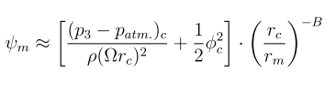
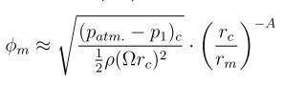
Vortex Exponent
SDG: 1 = free, -1 = forced

Slide 36
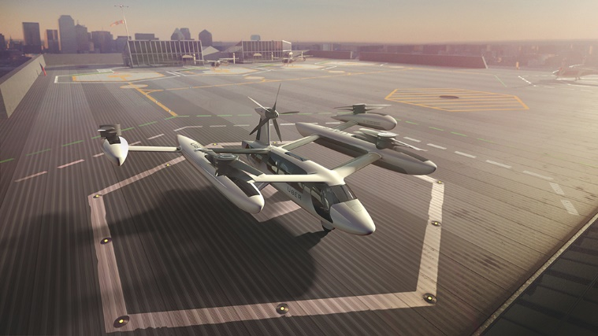
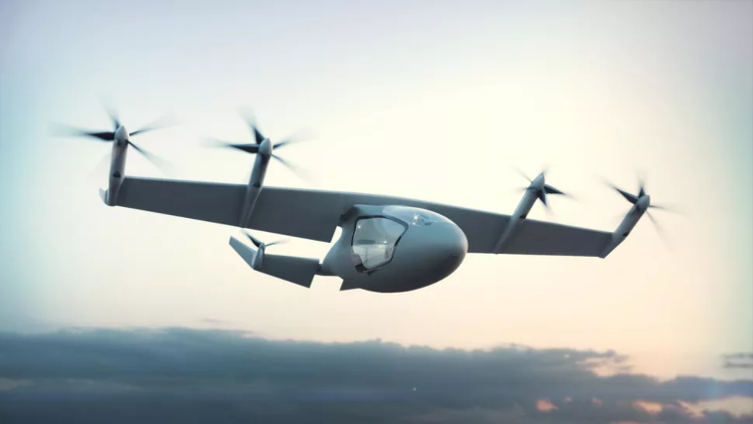
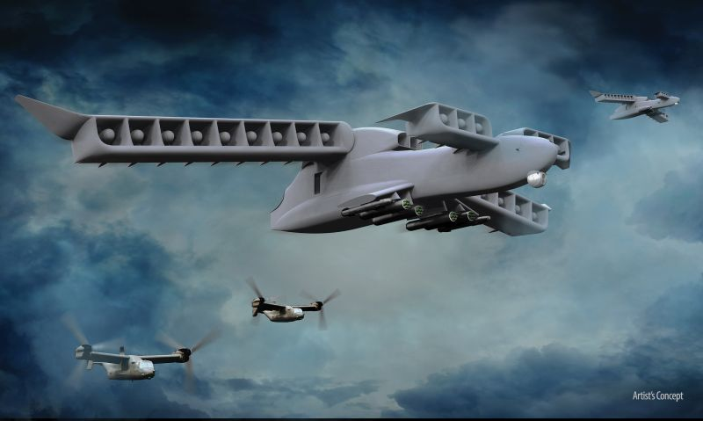
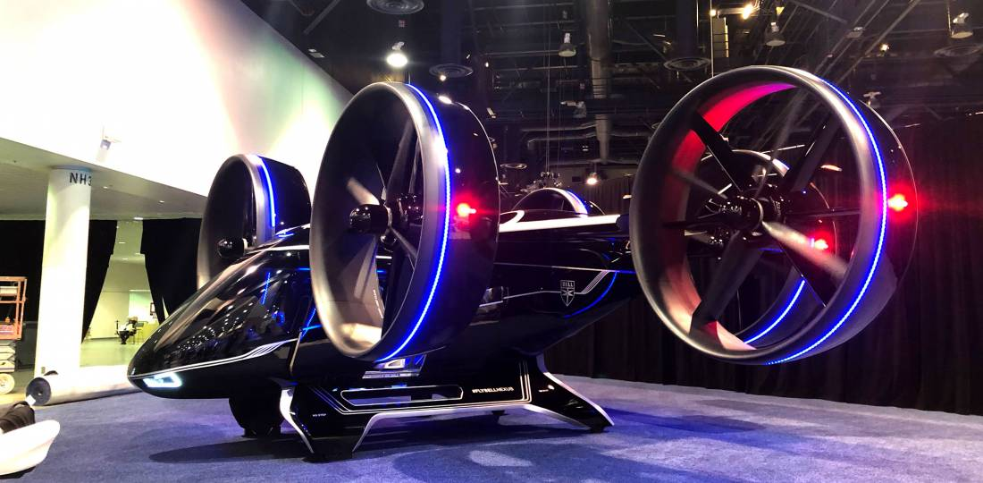
The Take-Off of e-VTOL
Ducted Fans
Higher thrust
Less Noise
Contained (Safer)
Do they work at a SYSTEM level?
BUT
Notes:
The e-VTOL market has exploded in the past few years and is projected to continue growing, trebling by 2024.
The market shows us that no one configuration is being sought after, with a vast array of designs put forward
PRIMARILY
PROPELLERS
DUCTED FANS
Ina static test, a ducted fan has a higher thrust output, is less noisy and is contained, meaning it is safer.
However does the cost of weight and stability prevent them from being a better propulsion system?
How we can determine whether ducted fans are a viable system solution to the e-VTOL propulsion problem>

Slide 37
Project Questions
Are ducted fans more efficient in static hover?
Are ducted fans dynamically stable in an e-VTOL application?
Notes:
This problem has two primary facets, arising from
A static analysis
A dynamic analysis
Firstly, the ducted fan as a system must be more efficient than a standard propeller in a static hovering configuration. Does the reduction in power requirement outweigh the increase in weight of the vehicle? Hence, ‘Are they a more efficient SYSTEM for e-VTOL vehicles?’
Secondly, the dynamic feasibility of the ducted fan is to be considered. How does the performance vary when the vehicle is subjected to lateral manoeuvres? Hence, ‘Are ducted fans FEASIBLE for an e-VTOL APPLICATION?’

Slide 38
Are ducted fans more efficient in static hover?
Does added efficiency outweigh weight penalty for a simple light-weight design?
Hover tests with variable payload
Quadcopter propulsors compared:
Generic off-the-shelf propeller
APC e-VTOL optimised propeller
Ducted Fan (??)
Notes:
Changing a propulsor from a propeller to a ducted fan introduces a significant increase in weight.
The design must therefore be weight minimized, however, does the increase in performance outweigh the extra weight required?
Tests will be conducted with various payloads to determine performance across the fan characteristic.
Need to design a ducted fan suitable for this test.

Slide 39
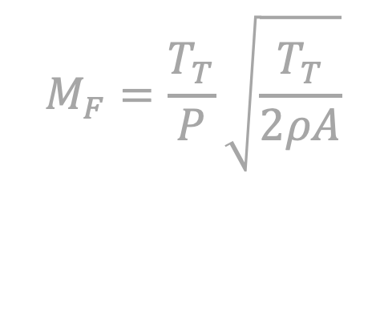
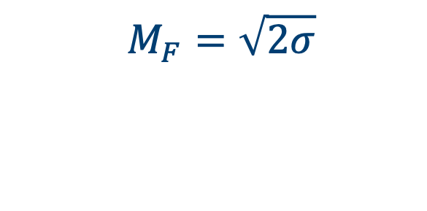


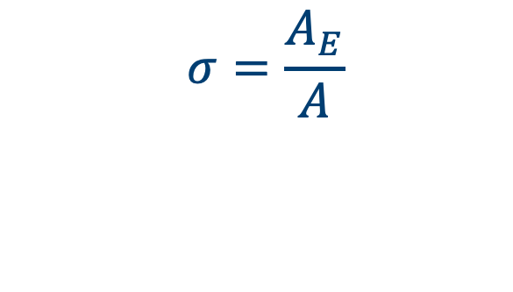
A Superior Figure of Merit
$$M_{F}=\frac{T_{T}}{P}\sqrt{\frac{T_{T}}{2ρA}}$$
$$A$$
$$A$$
$$A_{E}$$
$$M_{F}=1$$
$$M_{F}=\sqrt{2σ}$$
$$σ=\frac{A_{E}}{A}$$
Notes:
Need to quantify performance, SOMETHING TO MAXIMISE
Figure of Merit is a non-dimensional thrust to power ratio for a propulsor with zero freestream velocity, ie HOVER.
An ideal ducted fan can be shown to have a larger figure of merit than an open-rotor propeller, but this comes at the price of weight.
The diagram shows that an ideal propeller has a maximum FoM of 1. This is an absolute limit.
However, the ducted fan has another degree of freedom, the exit area of the diffuser can be varied and set (shown here as A_E). This control over flow area results in a FoM that has a dependence on the diffusion factor (SIGMA, defined here by A_E/A). This means an ideal ducted fan with a 1:1 diffuser has a FoM of 1.4, even without any diffusion.
Hence, how can the ducted fan be designed to maximise FoM in a system with a diffusion factor limited by both length and weight?
EXTRA
PROPELLER MODEL
Velocity actuator
Exit area NOT EQUAL to prop area (ie SMALL but non-unity FPR)
EXIT pressure equal to atmospheric
Consider ENERGY and MOMENTUM to get expression for area ratio

Slide 40







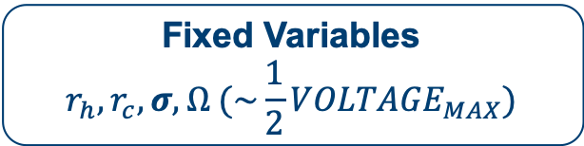

Reduction of Free Variables
Floating Variables
$$Φ, ψ$$
Fixed Variables
$$r_{h}, r_{c}, σ, Ω (\sim \frac{1}{2}{VOLTAGE}_{MAX})$$
$$Ω$$
$$T_{P}$$
$$σ^{2}=\frac{φ^{2}}{2ψ}$$
$$W_{P}$$
$$r_{h}$$
$$r_{c}$$
$$A_{E}$$
Notes:
The ducted fan has a broad design space that can be characterized by two variables, flow coefficient and stage loading (PHI and PSI)
The remaining variables have been fixed, either inherently by definition (sigma phi psi)
OR by geometric constraints (r_h)
OR by electrical limits (OMEGA)
However, there is no direct limit on the casing radius?
To close the problem, the thrust produced must be equal to the vehicle weight. I developed a mass model to relate both these quantities to the casing radius, and solving this problem at each design point, obtained the critical operating point for each.

Slide 41


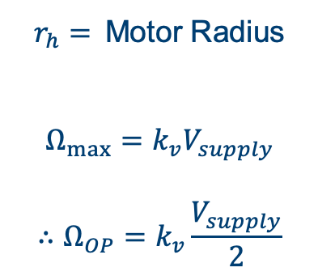
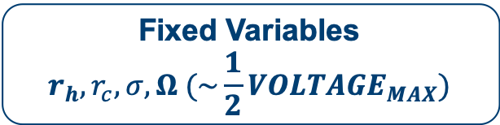

Reduction of Free Variables
Floating Variables
$$Φ, ψ$$
Fixed Variables
$$r_{h}, r_{c}, σ, Ω (\sim \frac{1}{2}{VOLTAGE}_{MAX})$$
$$Ω$$
$r_{h}=$Motor Radius
$$Ω_{max}=k_{v}V_{supply}$$
$$∴Ω_{OP}=k_{v}\frac{V_{supply}}{2}$$
$$T_{P}$$
$$W_{P}$$
$$r_{h}$$
$$r_{c}$$
Notes:
The ducted fan design has a broad design space that can be characterized by two variables, flow coefficient and stage loading (PHI and PSI)
The remaining variables have been fixed, either inherently by definition (sigma phi psi)
OR by geometric constraints (r_h)
OR by electrical limits (OMEGA)
However, there is no direct limit on the casing radius?
To close the problem, the thrust produced must be equal to the vehicle weight. I developed a mass model to relate both these quantities to the casing radius, and solving this problem at each design point, obtained the critical operating point for each.

Slide 42



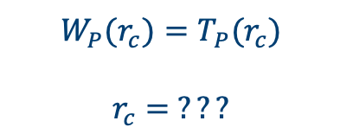
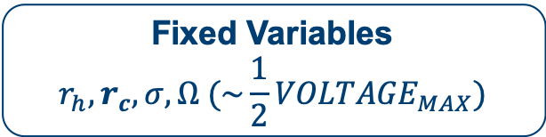
Reduction of Free Variables
Floating Variables
$$Φ, ψ$$
Fixed Variables
$$r_{h}, r_{c}, σ, Ω (\sim \frac{1}{2}{VOLTAGE}_{MAX})$$
$$Ω$$
$$T_{P}$$
$$W_{P}(r_{c})=T_{P}(r_{c})$$
$$r_{c}= ???$$
$$W_{P}$$
$$r_{h}$$
$$r_{c}$$
Notes:
The ducted fan design has a broad design space that can be characterized by two variables, flow coefficient and stage loading (PHI and PSI)
The remaining variables have been fixed, either inherently by definition (sigma phi psi)
OR by geometric constraints (r_h)
OR by electrical limits (OMEGA)
However, there is no direct limit on the casing radius?
To close the problem, the thrust produced must be equal to the vehicle weight.
I developed a mass model to relate both these quantities to the casing radius. Solving this problem at each design point obtains the critical operating r_c for design.

Slide 43
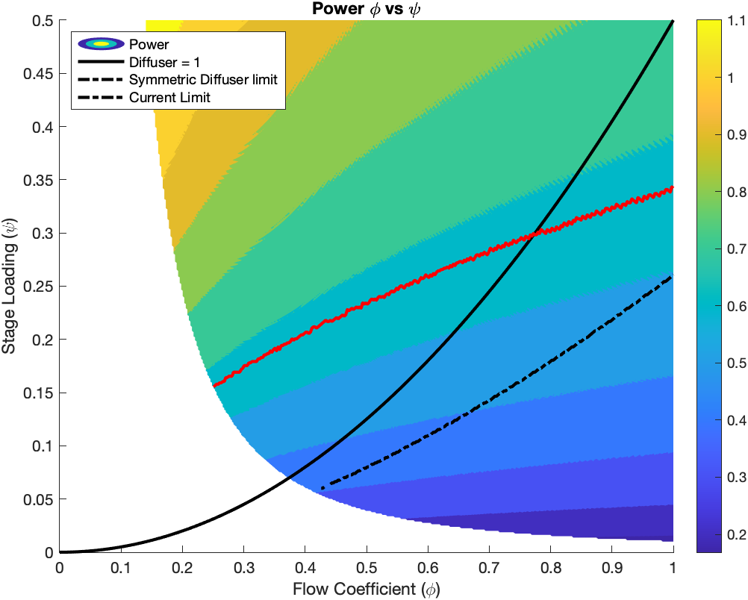

Maximise Figure of Merit, Minimise Power
Increasing $M_{F}$
Notes:
I developed this model to maximise FoM and Minimise power.
The diagram shows the power required at each design point.
There are limits shown.
The red line is a cuirrent limit for the motor
The Solid black line is the limit of diffusion factor =1
The dashed balck line is a geometric limit of diffusor symmetry.
This suggest we push the design towards the bottom left to reduce power.

Slide 44
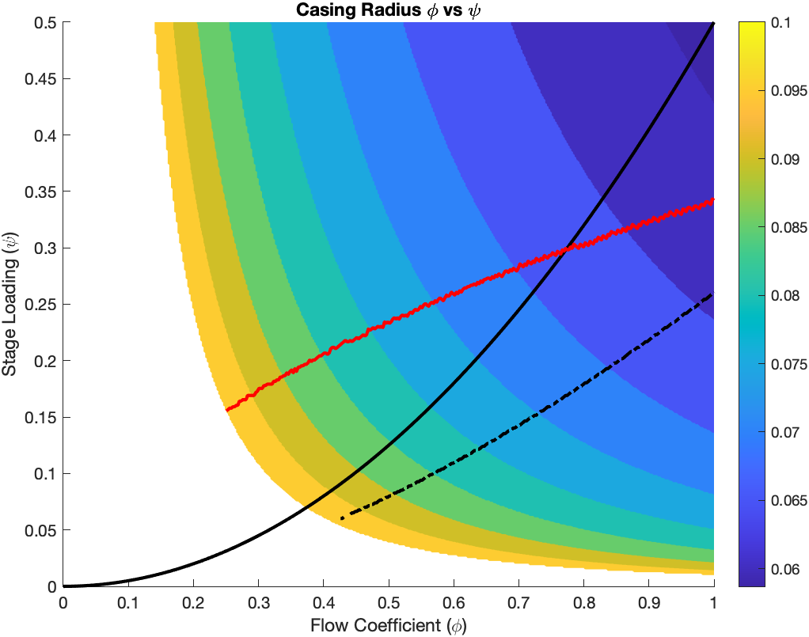
Minimise Power… What a big fan you have
Notes:
This slide shows the variation in casing radius across the design space.
Previously, we determined the bottom left is the ideal design region however, this shows those designs to be too large.
Therefore I have chosen a design in the middle of this region

Slide 45
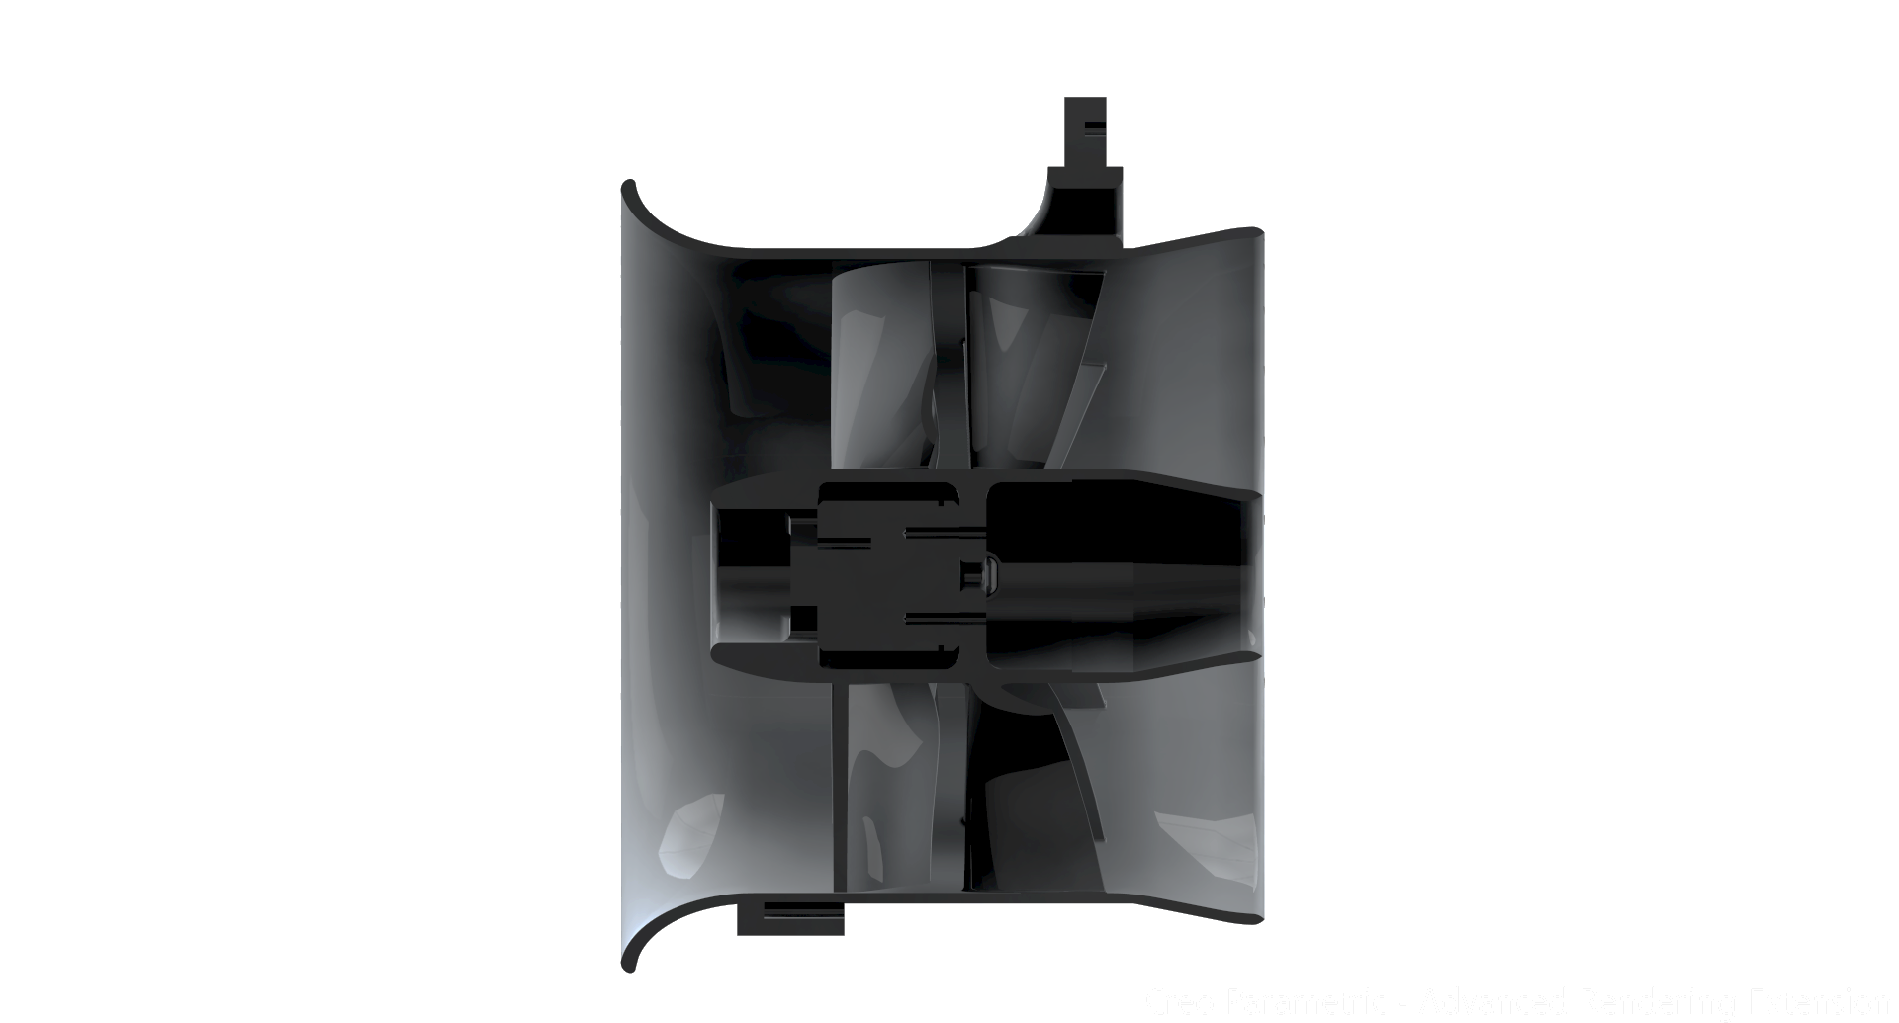
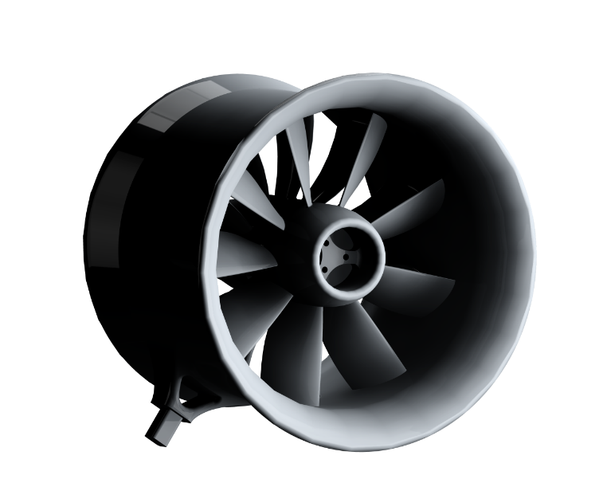
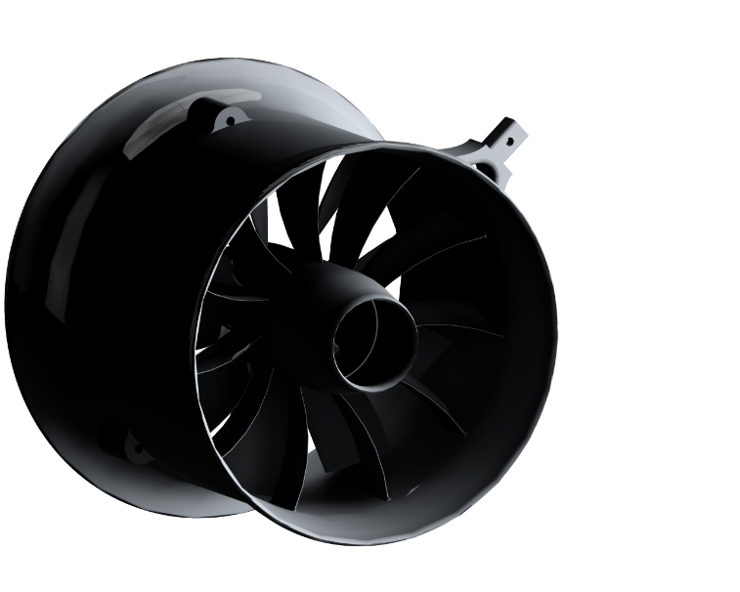
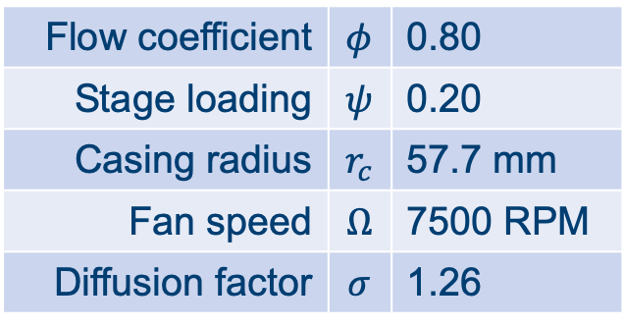
Chosen Design
Flow coefficient | $$φ$$ | 0.80
Stage loading | $$ψ$$ | 0.20
Casing radius | $$r_{c}$$ | 57.7 mm
Fan speed | $$Ω$$ | 7500 RPM
Diffusion factor | $$σ$$ | 1.26
Notes:
From my model, I have chosen this design.
A conservative diffuser and intake is used, that will be improved by the work Megan is going to talk about.

Slide 46
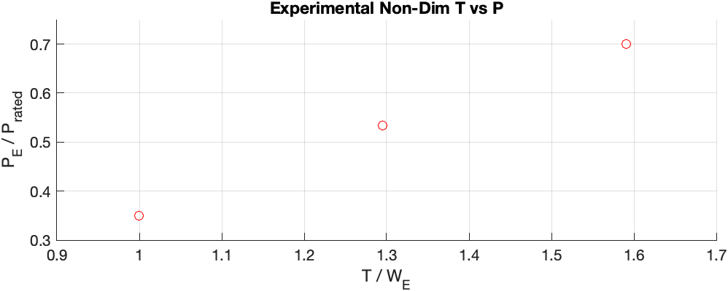
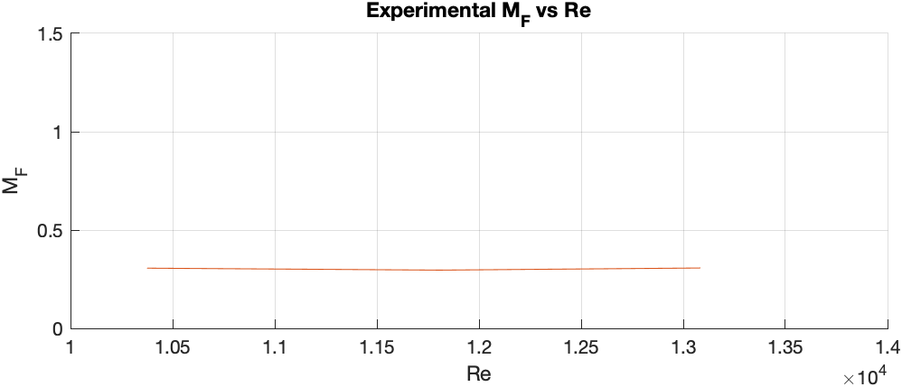

Preliminary Propeller Data – The Baseline
Power vs Thrust
Constant $M_{F}$ wrt $Re$
Notes:
The fan performnce will be compared against propeeller performance.
I have so far collected data for the propeller, shown here.
This shows teh propeller to have a constant FoM at various loads as expected. This FoM is fairly low as it is for an unoptimised propeller
I expect to see the hover optimized propeller closer to but still below 1, and the fan to be somewhere between 1 and 1.5
I will now talk about the dynamic aspect of the test.

Slide 47
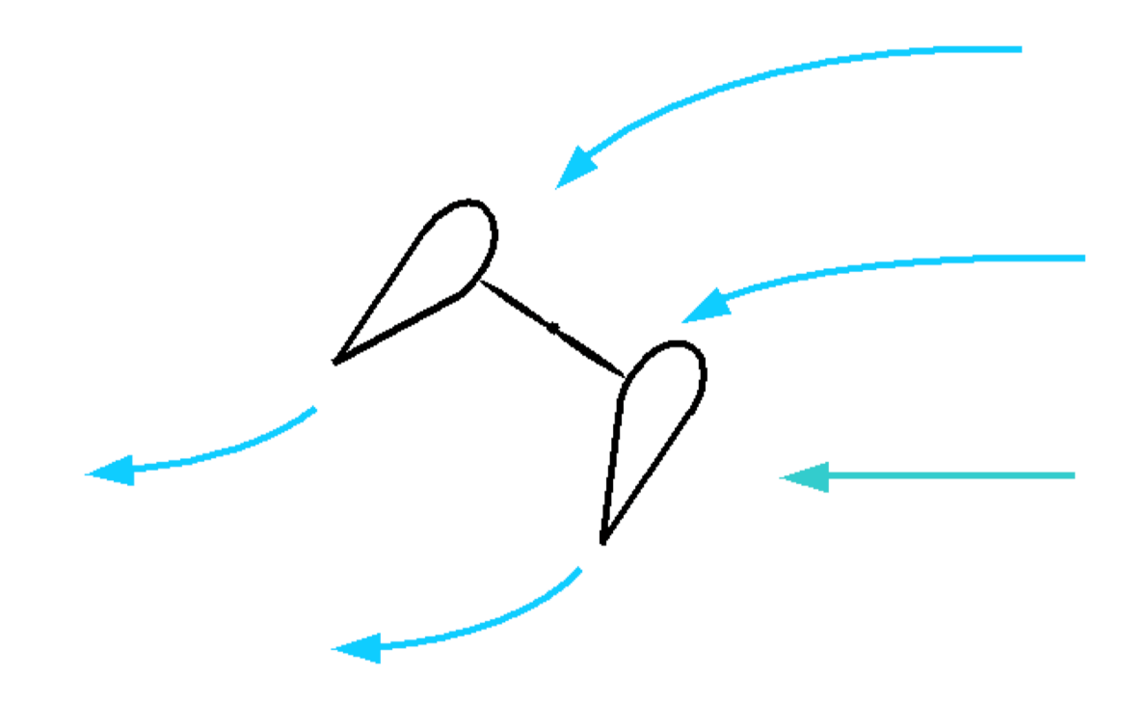

Are ducted fans FEASIBLE in an e-VTOL application?
Does the intake duct reduce dynamic stability during manoeuvres?
Small horizontal manoeuvres of varying amplitude
Dynamic stability determined:
Does separation occur at intake?
Does control system remain stable?
$$M$$
Vehicle Velocity
Notes:
Now the fan has been developed, the next question is that of dynamic performance,?
The primary concern here is how the fan behaves in a crosswind, a common flow feature for a vehicle transitioning from hover to horizontal flight. (AS IN THE DIAGRAM)
Crosswinds can lead to separation and resulting decrease in performance AS WELL as destabilising moments on the vehicle.
THEREFORE the key questions are
Does separation occur?
Does the vehicle remain stable?
A test bed is needed to determine this

Slide 48
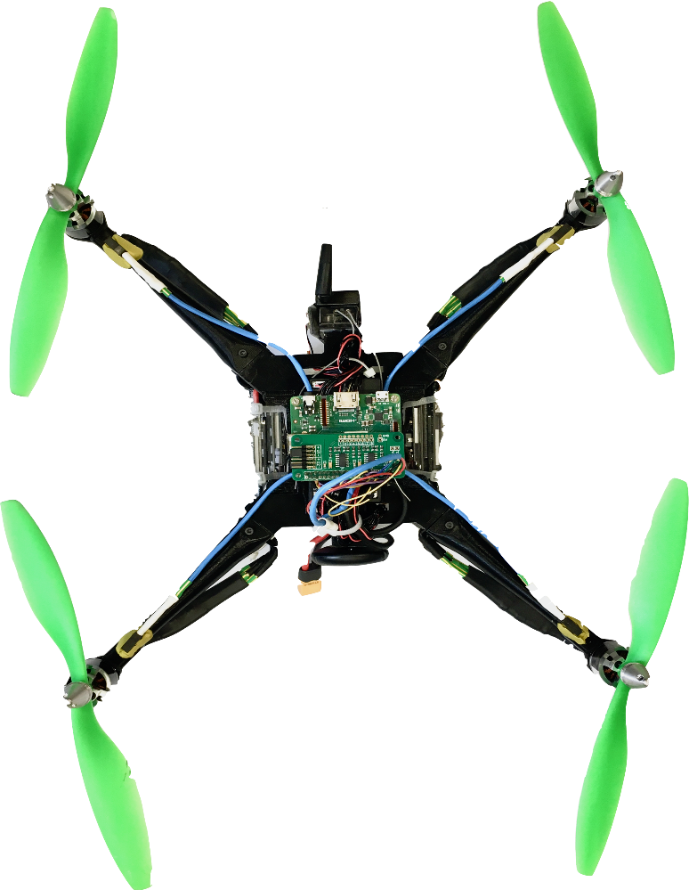
Modular Dynamic Test Bed
Work completed as part of UROP
Light-weight 3D printed parts (PLA)
Modular
Pixhawk4 flight hardware
Bespoke chassis
Additional Michaelmas work
RaspberryPi based on-board, real-time sensor hub
Sensor design, development and integration
Detachable Propulsor Assembly
(Ducted Fan or Prop)
Data Logging and Flight Control
Notes:
Here we see this test bed,
It has a cocentral data logging and flight control chassis,
as well as modular limbs and propulsor assemblies that are suitable for both ducted fans as well as propellers.
My design was 3D printed at the Whittle, allowing for rapid prototyping, also allowing the design to be as light as possible in my price-range (no carbon yet, sadly).
I have integrated flight control systems with a custom sensor management unit to provide on-board data logging and autonomous flight control.
This test bed allows all the required metrics to be determined…

Slide 49
Data Collection, Control and Conclusions
Figure of Merit
Power (Electrical, RPM, calibration)
Thrust
Flow separation at intake
Pressure Transducers
Control system stability
6-DoF inertial sensors
3 position sensors
Laptop
Pixhawk4 Flight Controller
Power Module (PM07)
RPi3 A+ Sensor Management
ONBOARD
ESC
ADC Breakout
RPM Sensors
Ultrasound Proximity Sensors
Pressure Transducers
Motor Assembly
Notes:
An overview of the system
Two main aspects to testing this way. The first is Control and the second is Data Collection.
This graphic shows the system level interactions involved.
Managing the vehicle as a whole is a laptop
The control aspect is handled by a Pixhawk4 Flight Controller that manages the stability of the platform.
Power and Motor control is shown on the LHS
The RHS shows the sensors and the RPi sensor hub.
I have developed a Raspberry Pi based sensor management unit that can record and transmit data. It includes up to 8-channel ADC that allows multi-stream data-logging remotely or on-board.
Sensors are integrated with the existing flight software to enable autonomous position control.
They allow both static and dynamic performance to be determined. These are shown on the left.
Figure of Merit is determined from Power and Thrust measurements
Flow separation comes from tappings and pressure transduces at the intake
Control stability can be determined from the flight control system
Using this test platform, I will be able to determine the performance of the fan in both a static AND dynamic context NExt term .
THANK YOU

Slide 50
Notes:
Back up slides
ESDU
LOW RE PROFILES FROM MATHEW M PAPER (DYSON)

Slide 51
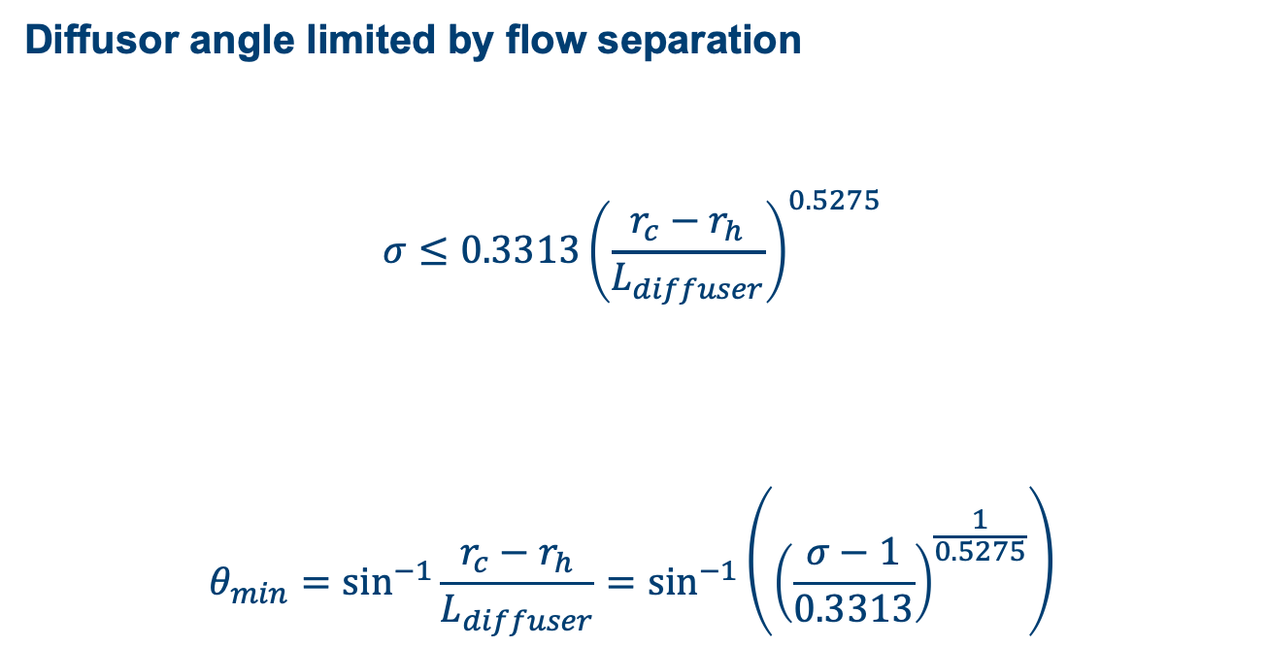
Mass Model
Diffusor angle limited by flow separation
$$σ≤0.3313{\left(\frac{r_{c}−r_{h}}{L_{diffuser}}\right)}^{0.5275}$$
$$θ_{min}=\sin^{−1}{\frac{r_{c}−r_{h}}{L_{diffuser}}}=\sin^{−1}\left({\left(\frac{σ−1}{0.3313}\right)}^{\frac{1}{0.5275}}\right)$$
Notes:
When considering the mass model, a hidden fixed geometric variable, diffuser length, is set by the maximum angle of the diffuser from the axial flow direction.
The constants shown here are obtain from empirically obtained data in ESDU 75026 and represent a conservative limit on diffuser separation.
The equation shows that this limit can be expressed solely in terms of SIGMA (diffusion ratio) and hence the operating point variables PHI and PSI.

